Slide 1
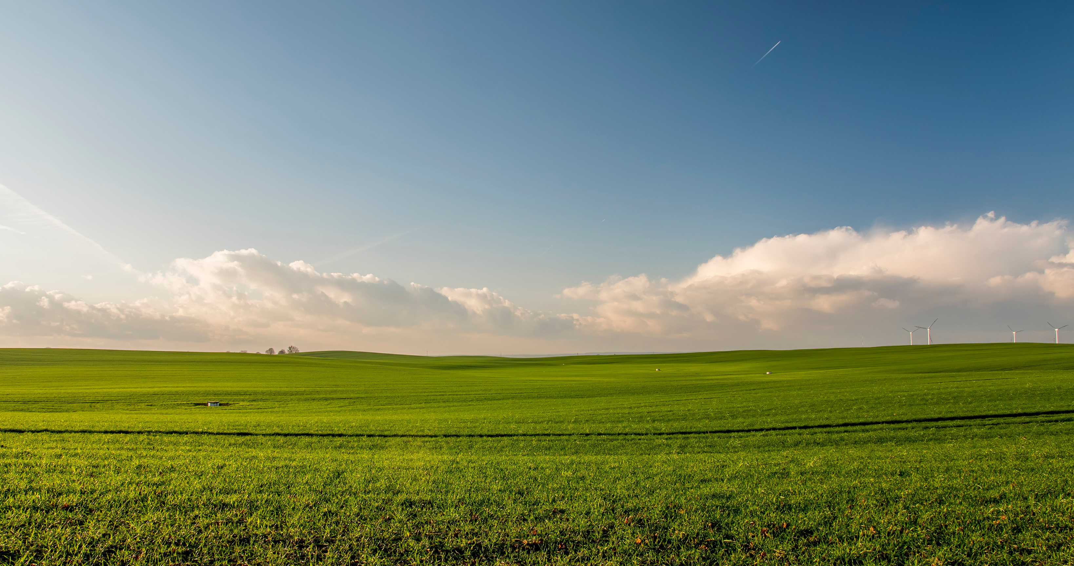
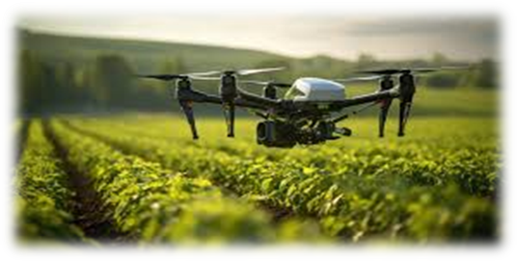


MSC. Data Science
UNSUPERVISED REPRESENTATION LEARNING WITH DEEP CONVOLUTIONAL GENERATIVE ADVERSARIAL NETWORKS FOR PRECISION AGRICULTURE
Supervisor:
Dr. Shagufta Henna
Student Number:
L00179080

Slide 2


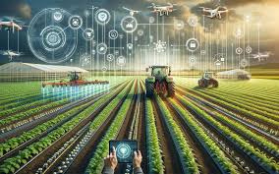
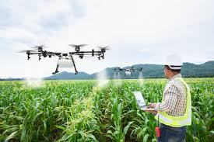
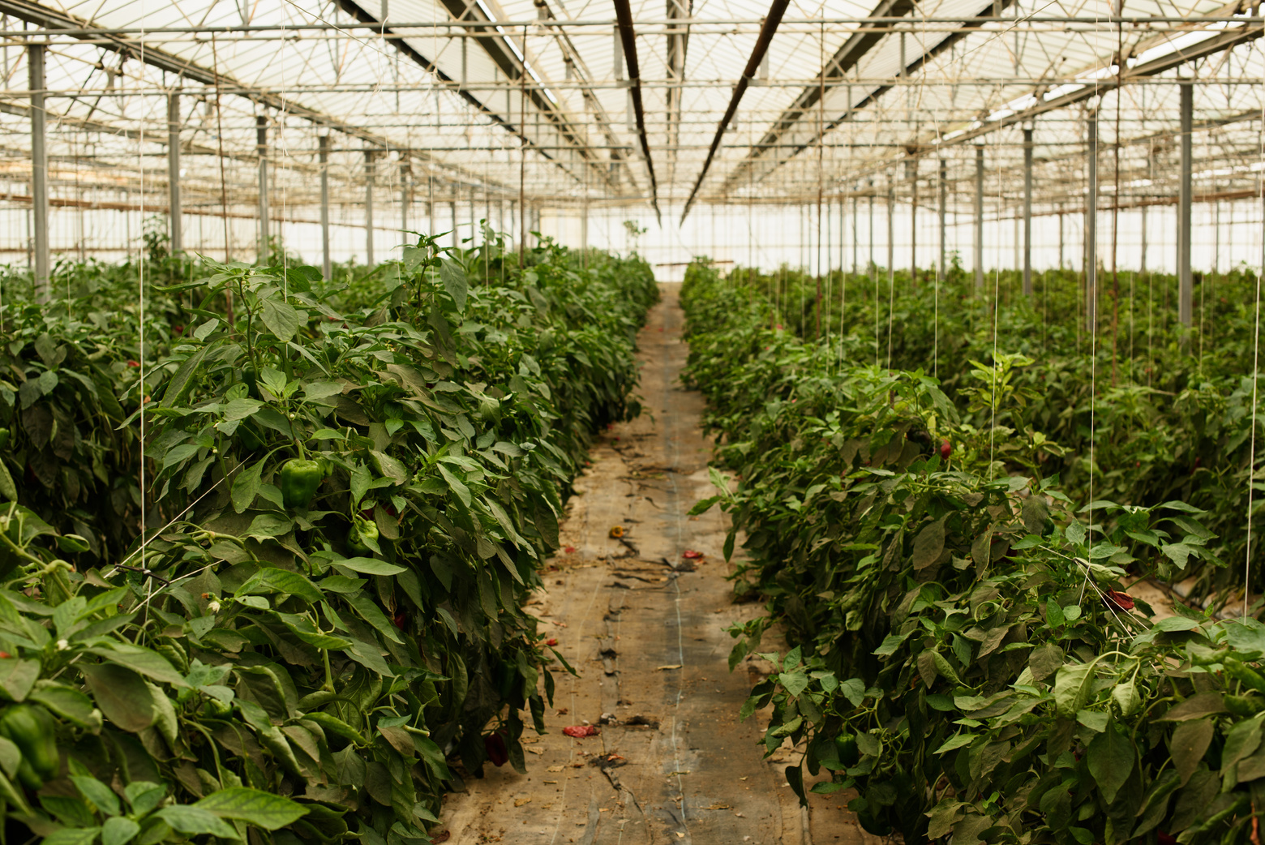
Precision Agriculture
Modern farming method utilizing technologies like IoT, AI, and ML.
Enhances crop productivity, optimizes resources, and reduces environmental impact.
Notes:
1. Crop yields can be improved by using PA.
2. We can make decisions with the help of sensors, analysis tools, we can save human efforts like to spray using Unmanned Aerial Vehicles (UAVs) which are also called as Drones

Slide 3
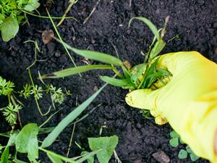
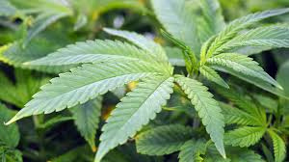
Introduction
Impact of Weeds on Crop Health and Yield
Nutrient Competition:
Weeds compete with crops for essential nutrients in the soil.
Leads to nutrient deficiency in crops, impacting growth and development.
Water Competition:
Weeds absorb significant amounts of water, reducing the availability for crops.
Notes:
1. Weeds prevent crop growth and yield by competing with crops for necessities like sunlight, water, and nutrients.
2.Weeds have the potential to completely destroy crops in critical situations by preventing the crop from accessing essential resources.
3.Farmers frequently use expensive and dangerous herbicides for controlling weeds.
4. A lot of applications of herbicides can harm beneficial organisms, pollute water sources, and create weed species that are opposed to the herbicide.
5.Farmers may face serious financial challenges the high cost of herbicides, particularly in developing nations.
6.Large-scale, traditional weed control techniques, such as manual labor, are frequently unsustainable and useless.

Slide 4
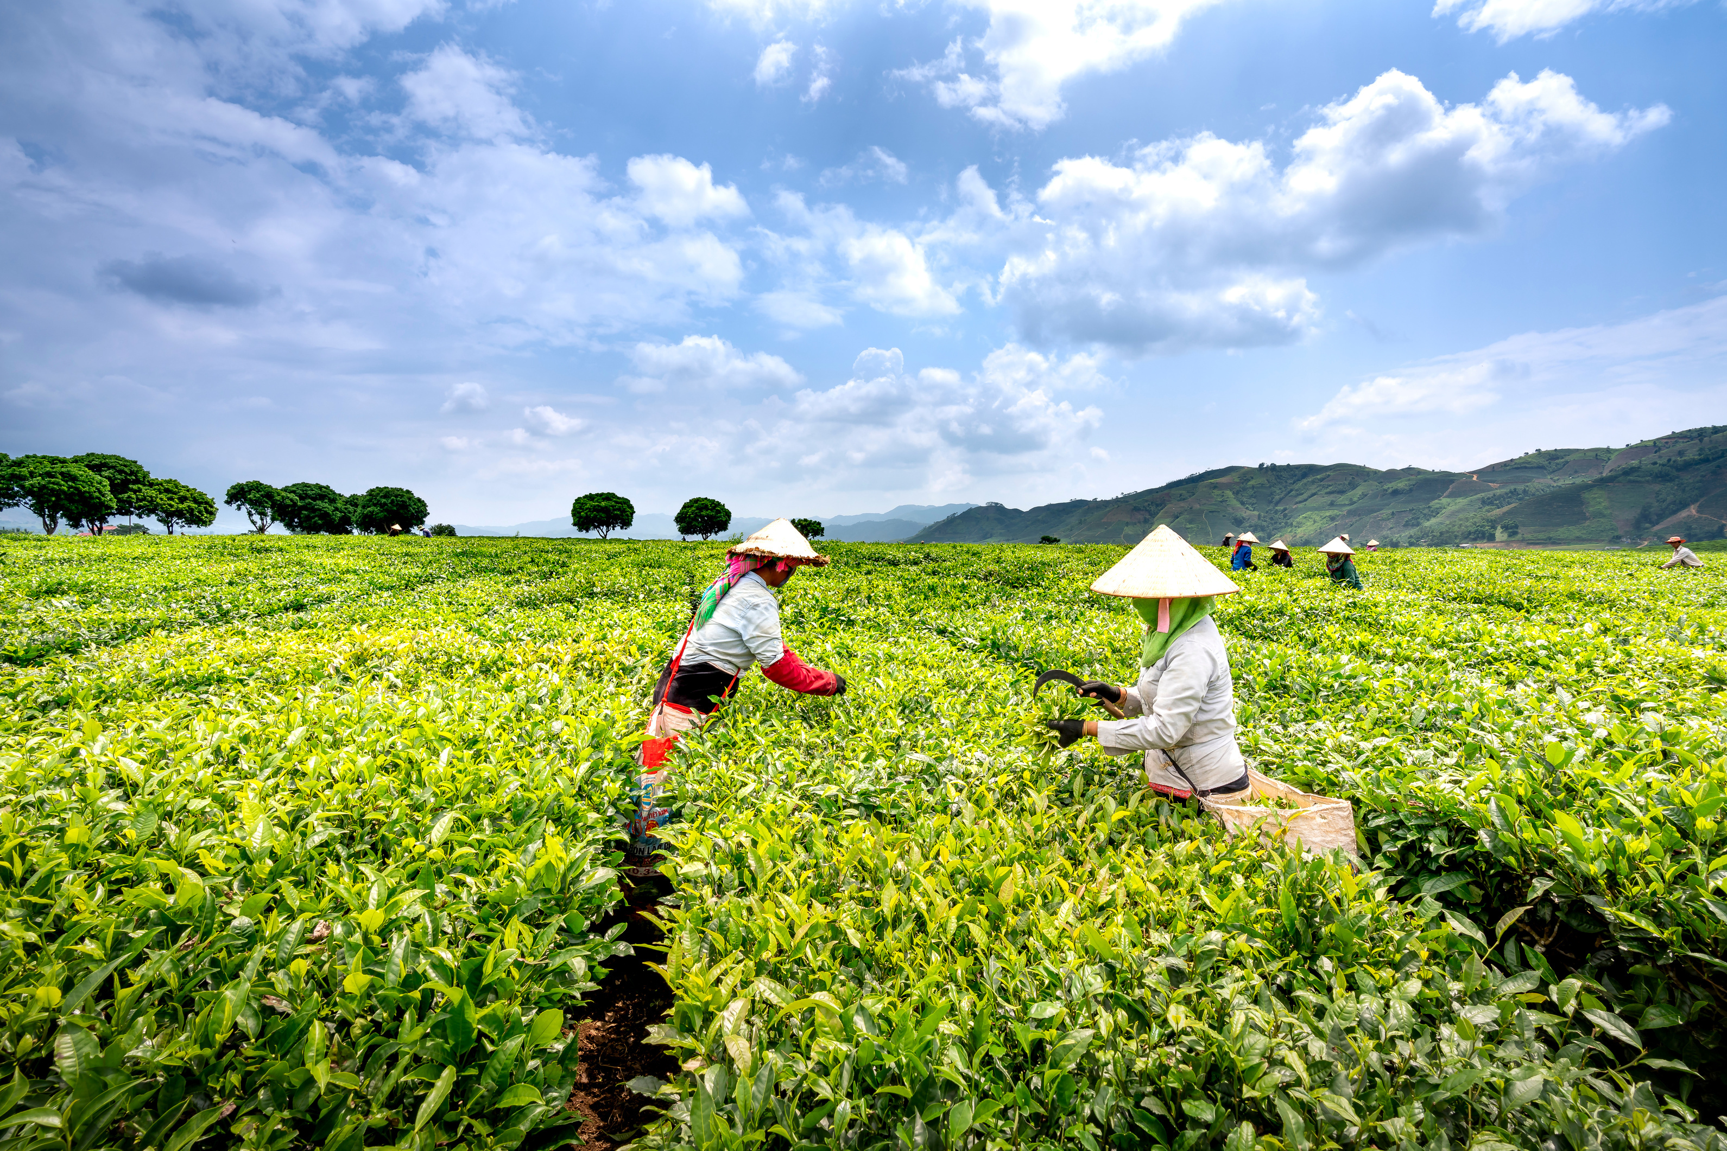
Related Work
1/3
(Hasan et al.'s 2021)
Focus on in-depth analysis of Deep Learning methods for weed classification and detection in agricultural photos.
Examine Deep Learning techniques in agriculture with a focus on weed identification, and discuss difficulties in differentiating weeds from crops that share characteristics.
Categorizes literature into four areas and highlights CNNs for image analysis and LSTMs for handling sequential data.
Deep Learning models perform better than conventional Machine Learning techniques, particularly when handling big datasets and automatic feature learning.
The lack of real-world data and practical challenges suggests including case studies to create a connection between theory and practice.
Hasan, A. S. M. M., Sohel, F., Diepeveen, D., Laga, H., & Jones, M. G. K. (2021). A survey of deep learning techniques for weed detection from images. ArXiv Preprint, arXiv:2103.01415.
Available at: https://arxiv.org/abs/2103.01415 [Accessed 05 July. 2024].

Slide 5
Related Work
2/3
(Pai, Kamath, and Balachandra 2024)
The main objective is to conduct an extensive evaluation of deep learning techniques for weed identification in agricultural environments, with particular focus on the changes in detection and localization.
Analyze existing Deep Learning-based weed detection methods, highlighting advances in precision and effectiveness for crop weed localization, identification, and classification.
An in-depth review of CNN architectures, including Deep Convolutional Neural Networks and Regional Convolutional Neural Networks, and how they can be integrated with modern technology like drones and UAVs to improve weed control.
Models are assessed based on their ability to distinguish between crops and weeds, considering image quality, color, and additional non-imaging detectors.
Despite positive results in controlled environments, challenges remain for practical deployment due to factors like climate change and species differentiation. The paper lacks discussion on scalability, field implementation, computational requirements, and the environmental and financial impacts of these technologies.
Pai, D. G., Kamath, R., & Balachandra, M. (2024). Deep Learning Techniques for Weed Detection in Agricultural Environments: A Comprehensive Review.
Available at: https://ieeexplore.ieee.org/stamp/stamp.jsp?tp=&arnumber=10570187[Accessed 07 July. 2024].

Slide 6
Related Work
3/3
(Kerdegari et al. 2023)
This paper focus on a semi-supervised GAN framework for classifying multispectral images in precision farming, specifically for weed growth detection using UAVs with multispectral cameras.
The semi-supervised GAN consists of two main components:
Generator Network: Generates realistic synthetic images from random noise to mimic the distribution of actual multispectral data.
Discriminator Network: A modified DCNN that performs multi-class classification (crop, weed, background) and distinguishes between real and synthetic images.
The approach was tested using multispectral images (Red and NIR channels) with varying percentages (30%, 40%, and 50%) of labeled data, achieving an F1 score of approximately 0.85 with 50% labeled data.
Although the semi-supervised GAN produces encouraging results, there are limits to how many datasets and scenarios it can be applied to. To improve stability and application, future research could examine more multispectral bands and assess how well the model performs in various agricultural contexts.
Kerdegari, H., Razaak, M., Argyriou, V., & Remagnino, P. (2023). Semi-supervised GAN for Classification of Multispectral Imagery Acquired by UAVs. Precision Agriculture.
Available at: https://arxiv.org/pdf/1905.10920[Accessed 12 July. 2024].

Slide 7

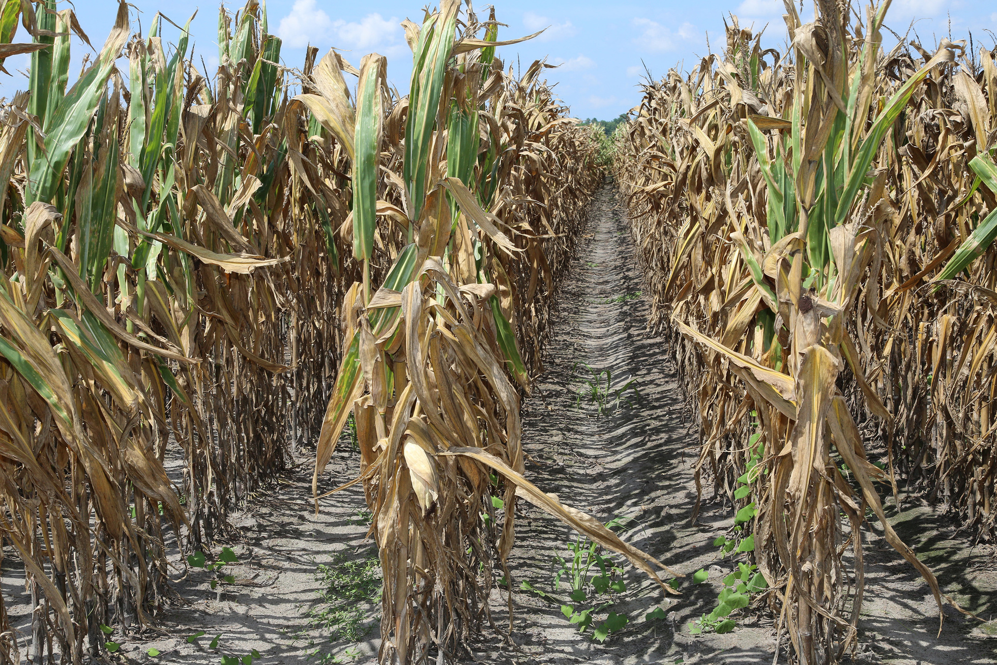

Problem Statement
By competing with crops for essential resources like nutrients, water, and sunlight, weeds lower crop production.
Manual weed control is expensive, time-consuming, and often ineffective.
Machine learning models struggle with limited data and class imbalance, leading to reduced accuracy.
High false-positive rates in weed detection increase herbicide use, negatively affecting the environment.
An accurate, automated weed detection system is needed to overcome data limitations and class imbalance, improving detection for both common and rare weed species.
Notes:
1. Weed will affect to the crops in such a way that they will consume all the required resources which is mostly required for the crop growth because of that crops are getting damage and it will leads to low yield.
2. To reduce the manual weed control like to spray pesticides , etc. that may also affect the crops growth as some times human may spray more on the actual crops side.
3. various models are developed like ML, DL to get the exact location of crops but still its facing an issues like class imbalance, weather forecast, etc..

Slide 8

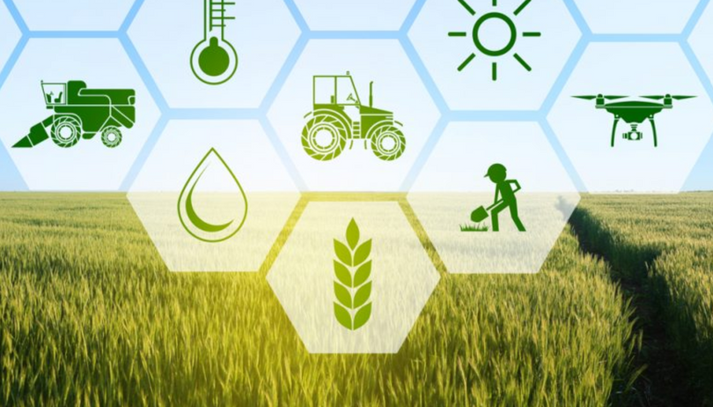
RESEARCH QUESTIONS
1
How effectively can DCGANs generate synthetic UAV imagery that closely resembles real-world UAV-captured images in terms of visual and statistical similarity?
2
Can the inclusion of DCGAN-augmented synthetic UAV imagery improve the classification accuracy of CNN models for weed identification in Precision Agriculture?
Notes:
Q1-> The first question looks at how well DCGANs can create artificial images that mimic real UAV images, making the augmented data realistic and appropriate for CNN model training.
Q2-> Question 2 looks into whether adding synthetic data to the training process improves the CNN models' performance in real-world agricultural scenarios by making them more accurate at classifying weeds.

Slide 9
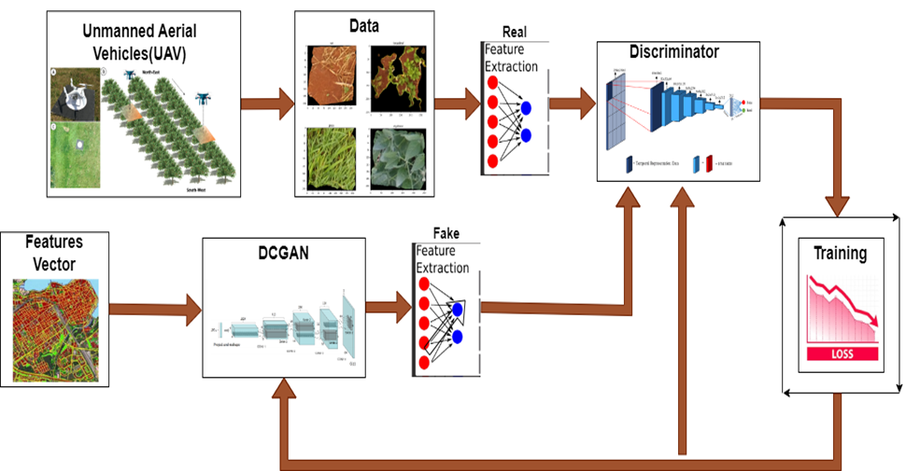
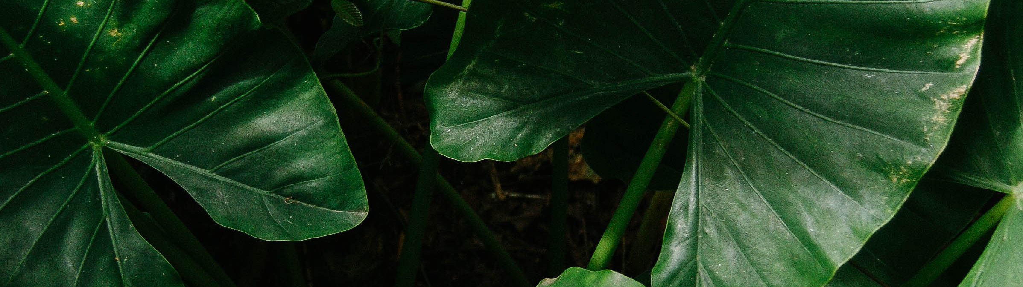
Proposed Solution
Notes:
1. Unmanned Aerial Vehicles (UAVs) capture aerial images of fields.
2. Prepare the data for a model by extracting relevant features.
3.Real: Features are extracted from the real UAV images using a method (likely a CNN).
4.Fake: A DCGAN generates synthetic images from a feature vector. Features are then extracted from these fake images.
5. The discriminator is a neural network that learns to differentiate between the real and fake features.
6. Training: discriminator is trained using both real and fake features, with the goal of minimizing its classification loss.
7. The generator in the DCGAN also receives feedback from the discriminator to improve its ability to create realistic fake images.
8. The main aim is to train a robust weed detection system that can accurately identify weeds in real-world field images.

Slide 10
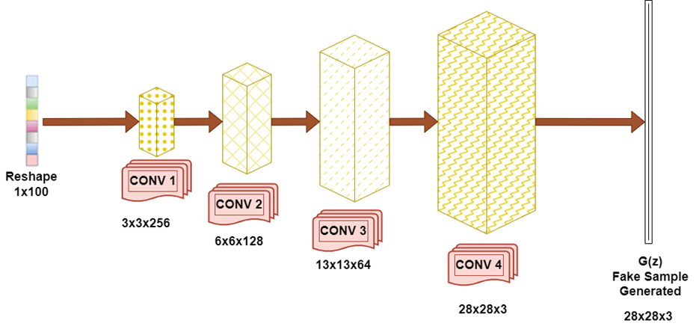
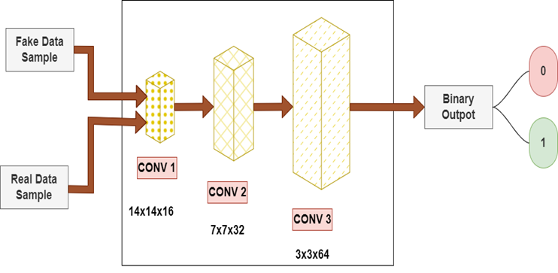
DCGAN DEsign
Generator
Discriminator
The figure shows how a generator network in a DCGAN is constructed and how a random noise vector is converted into a synthetic image.
The architecture of a discriminator network, which is used in a DCGAN, is shown in the diagram. The goal is to use extracted features to classify input data samples as real or fake.

Slide 11
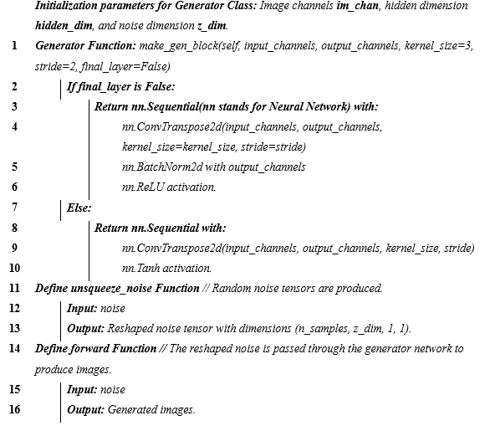
Generator Algorithm

Slide 12
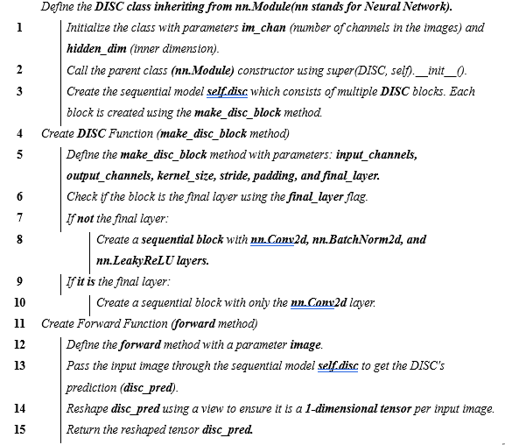
Discriminator Algorithm

Slide 13
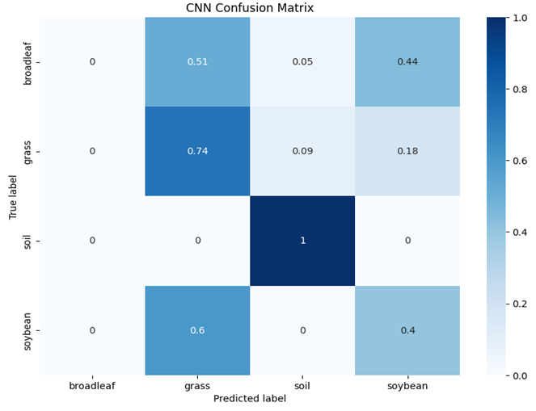
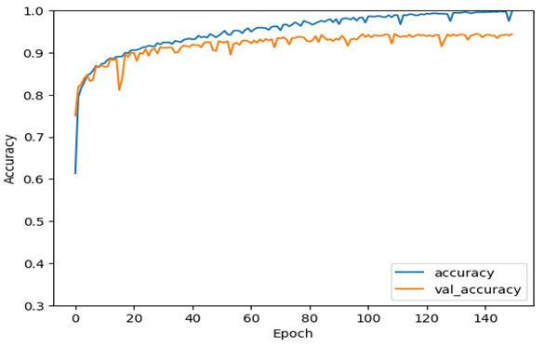
Results Without Augmentation
CNN Accuracy Score
CNN Confusion Matrix
Notes:
Confusion Matrix
Soil: Perfect classification (100% accuracy).
Soybean & Grass: Decent performance.
Soybean: 60% accuracy, with 40% misclassified as broadleaf.
Grass: 74% accuracy, with misclassifications mainly into broadleaf (9%) and soybean (18%).
Broadleaf: The most challenging class.
Only 51% accuracy.
Significant confusion with soybean (44%).

Slide 14
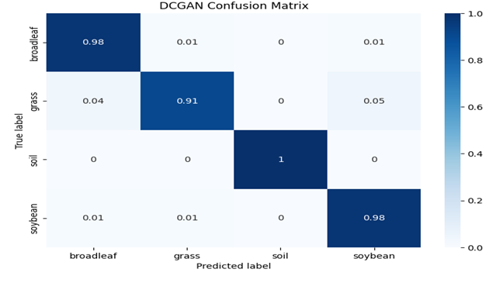
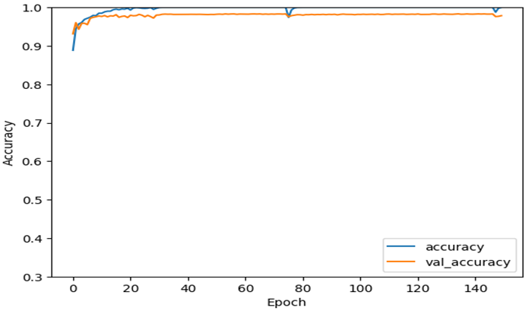
Results With DCGAN Augmentation
1/2
CNN Result with DCGAN
DCGAN Confusion Matrix
Notes:
Confusion Matrix
Broadleaf & Soybean:
Misclassifications between these two drastically reduced. Now both have 98% accuracy!soybean (44%).
Grass:Still some confusion with broadleaf, but overall better accuracy (91%)
Soil:
Remains perfect - 100% accuracy

Slide 15
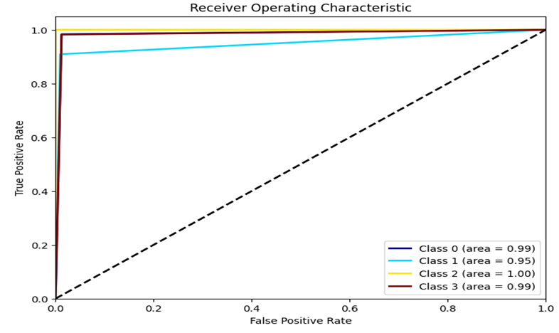
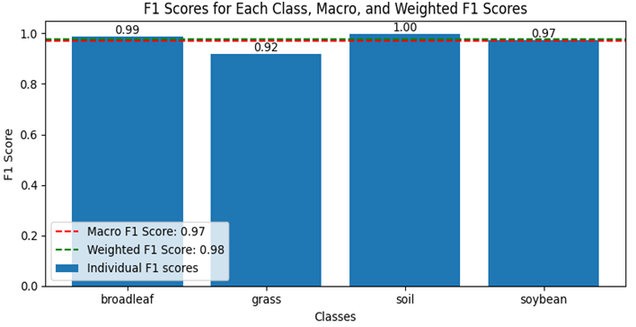
Results With DCGAN Augmentation
2/2
F1 Score
AUC ROC Curves
Notes:
Confusion Matrix
Broadleaf & Soybean:
Misclassifications between these two drastically reduced. Now both have 98% accuracy!soybean (44%).
Grass:Still some confusion with broadleaf, but overall better accuracy (91%)
Soil:
Remains perfect - 100% accuracy

Slide 16
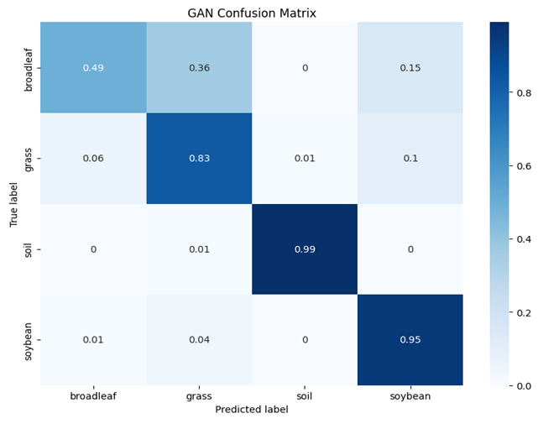
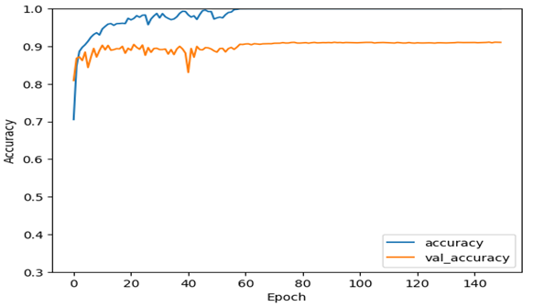
Results With GAN Augmentation
GAN with CNN Accuracy Score
GAN with CNN Confusion
Matrix
Notes:
Confusion Matrix
Broadleaf & Soybean:
Misclassifications between these two drastically reduced. Now both have 98% accuracy!soybean (44%).
Grass:Still some confusion with broadleaf, but overall better accuracy (91%)
Soil:
Remains perfect - 100% accuracy

Slide 17
Conclusion
To improve CNN's performance in weed identification within precision agriculture, this thesis investigated the use of DCGAN for data augmentation. It addressed issues such as class imbalance and a lack of training data.
The CNN model performed inconsistently throughout classes without data augmentation, showing complete accuracy for soil but notable rates of misclassification for broadleaf and soybean.
The CNN struggled particularly with differentiating between soybean and broadleaf due to their similar features, made worse by differences in class.
The artificial images produced by DCGAN led to a noticeable increase in model accuracy, a decrease in overfitting, and an improvement in class representation, particularly for minority classes.
The model trained with DCGAN augmentation achieved near-perfect accuracy on both training (1.00) and testing (0.98) sets, exceeded the non-augmented model.
This research demonstrates the potential of GAN-based augmentation for addressing class imbalance and data limitations in precision agriculture. However, further research is needed to refine these methods and ensure they capture real-world data complexities without introducing new biases.

Slide 18
Future Works
Some of the work is required for further studies as there are some drawbacks. More investigation is required on different GAN architectures and methodologies to optimize synthetic data generation for specific agricultural tasks.
Explore combining GANs with other machine learning strategies, such as Transfer Learning or Active Learning , to further enhance model performance.
Focus on the practical deployment of GAN-augmented models in real agricultural systems, addressing challenges like scalability, computational cost, and data collection.
Create effective, lightweight GAN architectures that can be used on edge devices such as drones or tractors to enable their wide use in precision agriculture.
To enhance the generalization, robustness, and accuracy of AI models in precision agriculture and ultimately encourage more efficient and sustainable farming methods, continue to enhance GAN-based data augmentation.

Slide 19
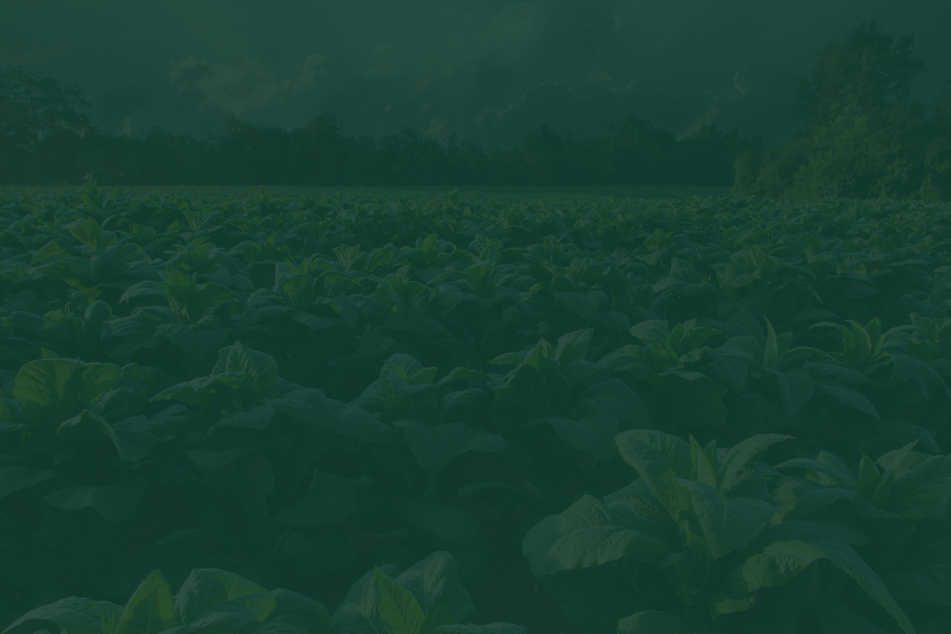
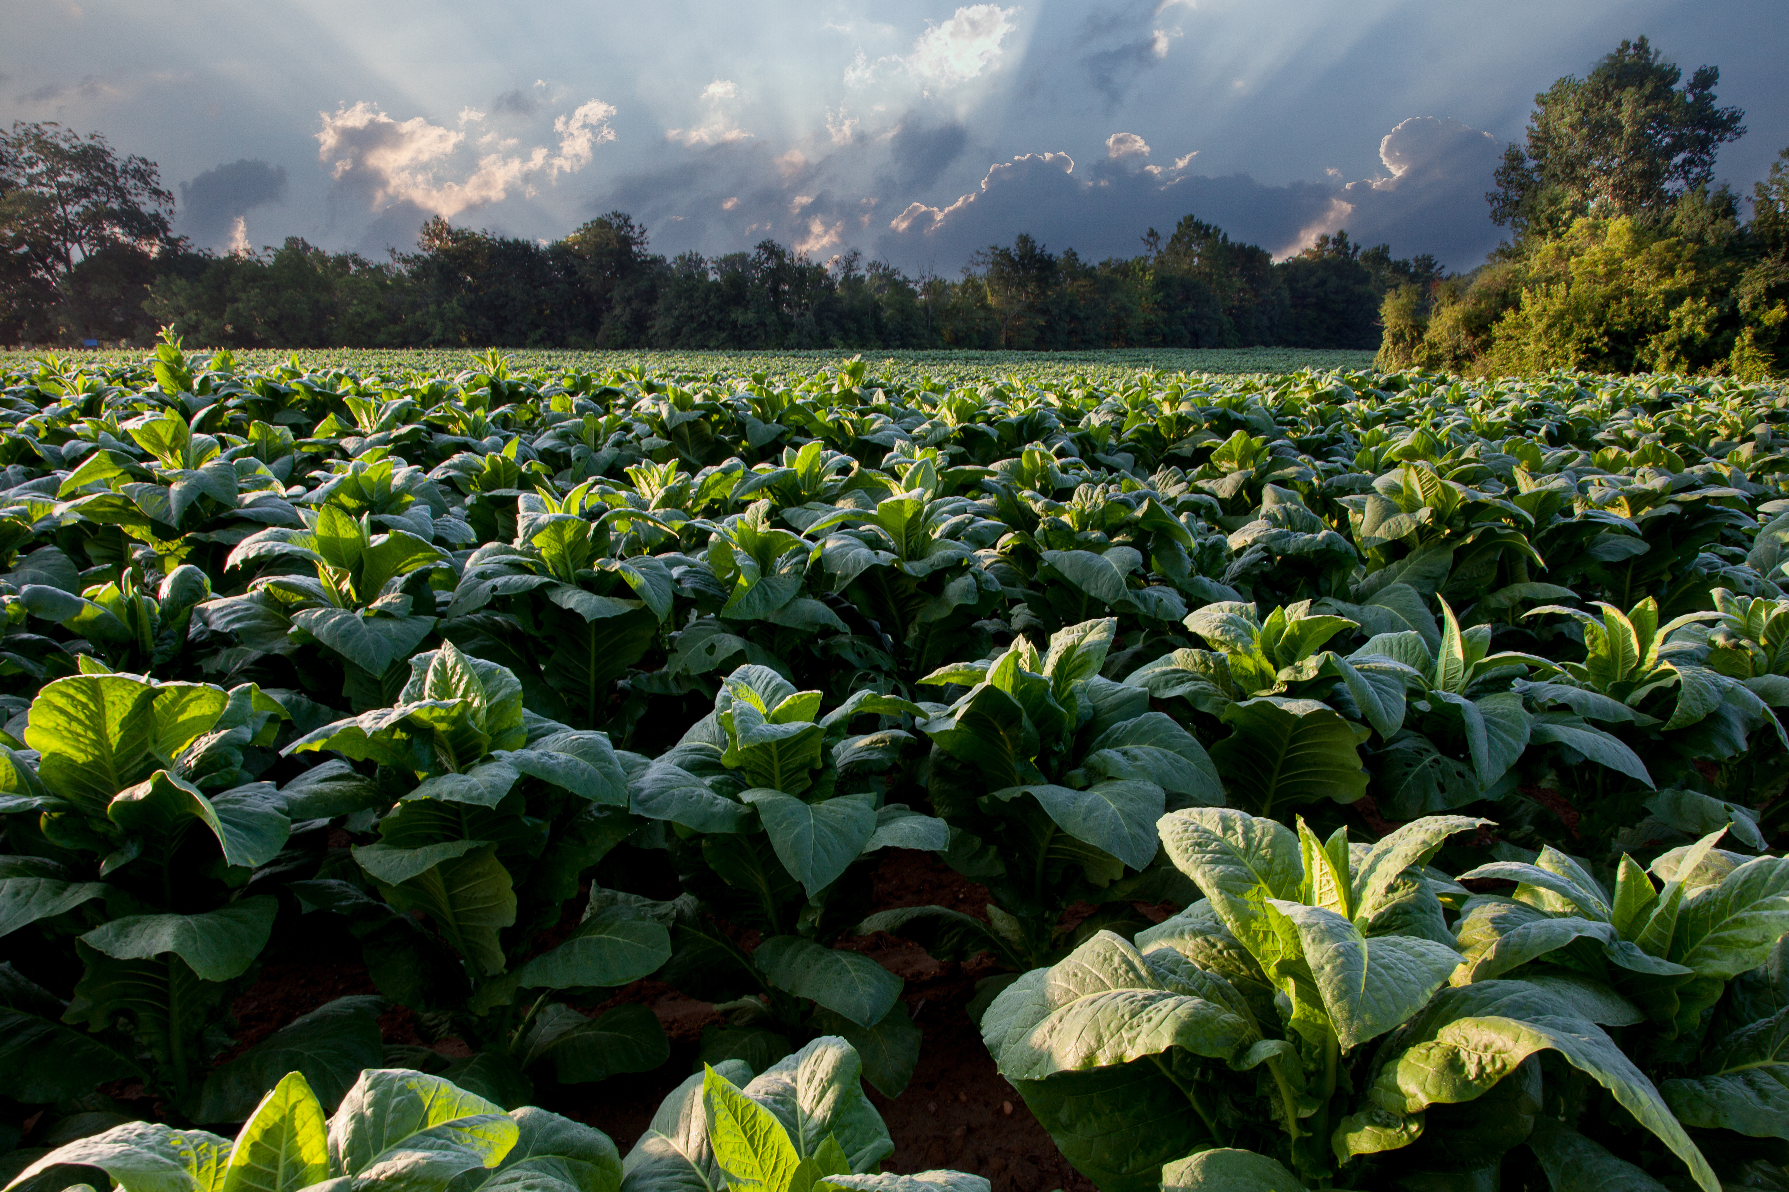
Thank You!

